Slide 1


FRESHERS CAFE
TEAM MEMBERS:
ABHIRAM REDDY(2303A51827)
TEJESH(2303A51812)
PRAJWAL(2303A51830)
COURSE:
HUMAN-COMPUTER INTERFACE
INSTRUCTOR:
FAZIA IRAM
DATE: 06/11/2024

Slide 2


The coffee website aims to create a comprehensive online platform for coffee lovers, providing access to high-quality coffee products, educational resources, and community engagement. The site will cater to both casual drinkers and connoisseurs, promoting a deeper appreciation for coffee culture.
.
Target Audience:
1. Coffee lovers
2. Employes in software sector
3. MNC Employes
4. Students

Slide 3

what user needs?
1. Good Coffee : People want high-quality and unique coffee.
2. Helpful Info : They need tips on how to brew coffee and learn about it.
3. Easy Shopping: They want a simple way to buy coffee online.
4. Connection : Users want to meet and share with other coffee fans.
5. Eco-Friendly : Many prefer coffee that is sustainably sourced.
some common challenges in existing systems:
1. Fake products
2. Getting different item
3. Taste difference
4. Low quality and High coast

Slide 4
Initial Idea
Concept: An online platform for coffee lovers to discover and purchase premium coffee.
Goal: To create a convenient and enjoyable coffee shopping experience.
Inspiration
Personal Journey: My love for coffee and discovering unique blends.
Market Gap: Noticing a lack of curated online options for quality coffee.
Core Features
User-Friendly Design: Easy navigation for seamless shopping.
Diverse Product Range: Specialty coffees, brewing equipment, and accessories.
Subscription Service: Monthly delivery of curated coffee selections.
Educational Content: Brewing tips and coffee guides to engage customers.

Slide 5
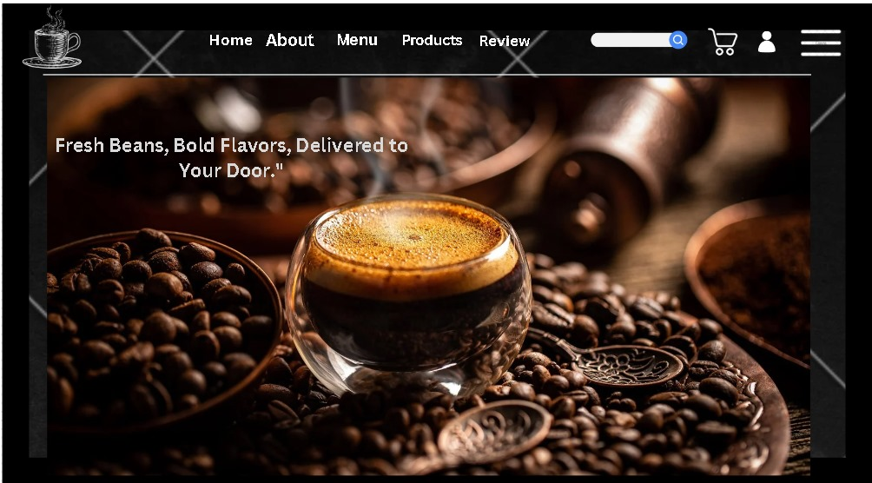

1. Home Page Wireframe
Header: Logo, Navigation Menu (Shop, About Us, Contact, Account)
Hero Section: Large image with caption
Product Page Wireframe
Product Image: Large display with thumbnail images.
Product Details: Title, price, description, and customer reviews.
Add to Cart: Button with quantity selector.
Related Products: Section for suggestions based on the current product.
Tools Used for Wireframing
Canva is used for interface
Canva is a user-friendly graphic design platform for creating visuals like social media posts, presentations, and posters using templates and a drag-and-drop interface

Slide 6

User Experience (UX)
Focus on intuitive navigation, clear layout, and engaging visuals to enhance user satisfaction.
Following 8 goldens Rules
Usability Principles
Consistency: Use familiar design elements.
Feedback: Provide clear responses to user actions (e.g., order confirmations).
Simplicity: Keep the design uncluttered and straightforward.
Accessibility
Text Alternatives: Use alt text for images.
Keyboard Navigation: Ensure the site is navigable via keyboard.
Color Contrast: Maintain high contrast between text and background for readability.

Slide 7
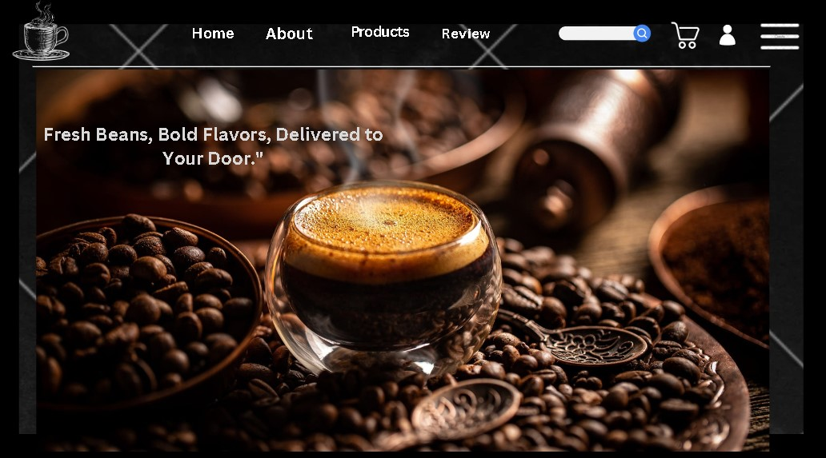

Slide 8
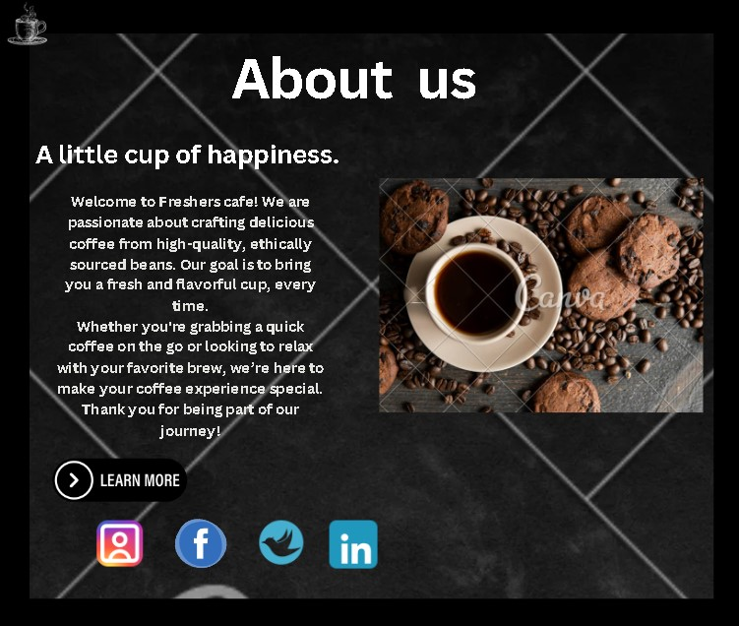

Slide 9
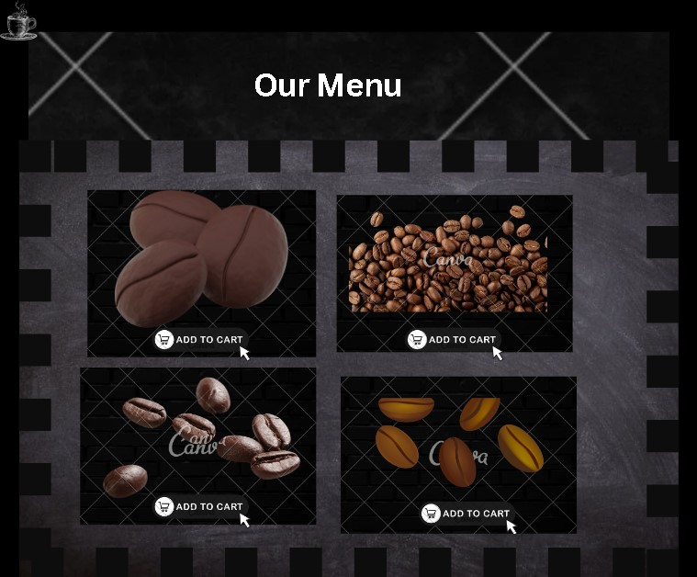

Slide 10
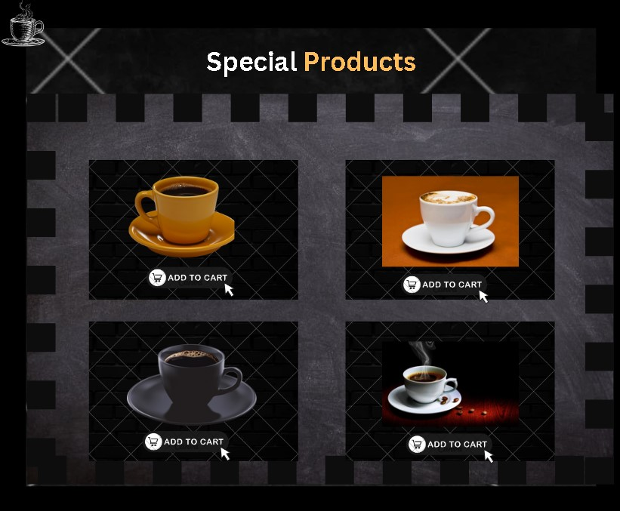

Slide 11
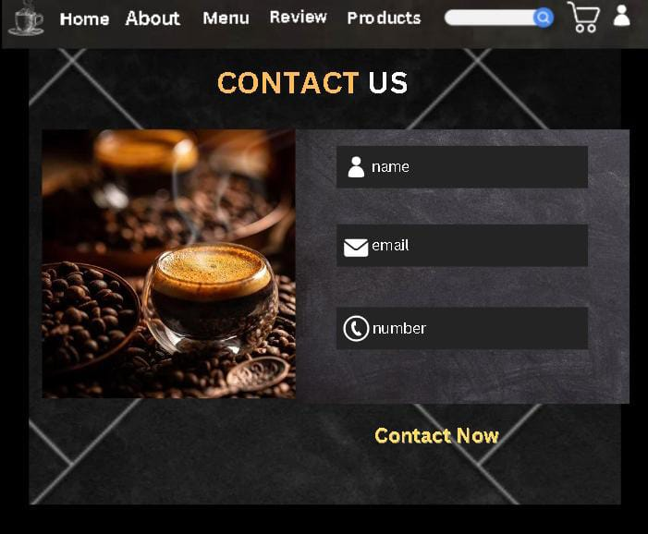

Slide 12
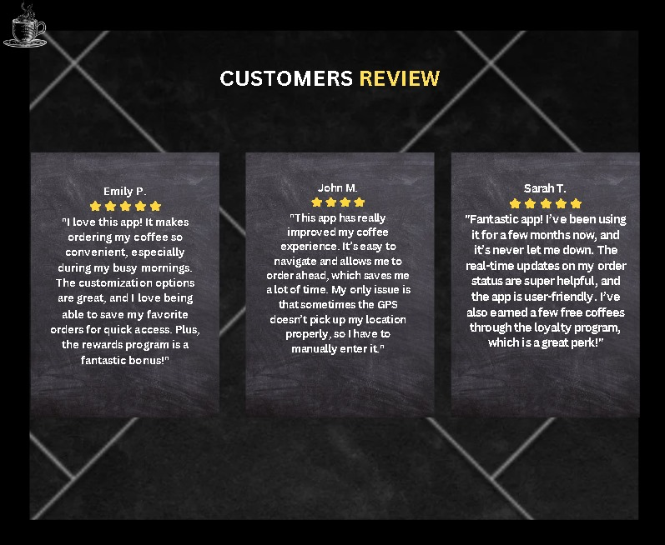

Slide 13
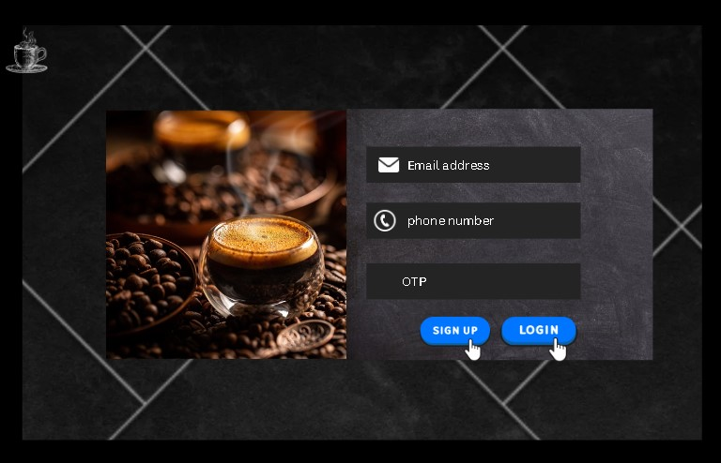

Slide 14
DEMO LINK
https://www.canva.com/design/DAGRwVV0HkU/DNDtsHGFEQT1dy1NzBLh0A/edit?utm_content=DAGRwVV0HkU&utm_campaign=designshare&utm_medium=link2&utm_source=sharebutton

Slide 15
Summary of Prototype
The prototype is a basic online coffee website that features a user-friendly interface, showcasing products, a shopping cart, and easy navigation. Key design elements include responsive layouts and clear calls to action.
Future Work
User Testing: Conduct tests to gather feedback and improve usability.
Enhanced Features: Integrate advanced filtering options and personalized recommendations.
Accessibility Improvements: Implement further accessibility enhancements based on user feedback.

Slide 16
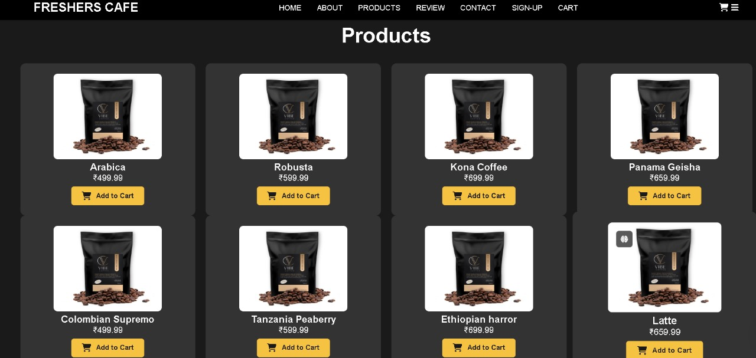
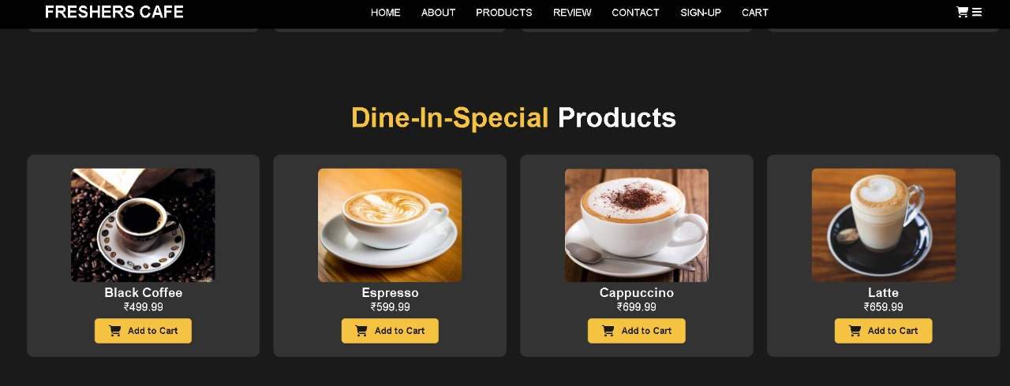
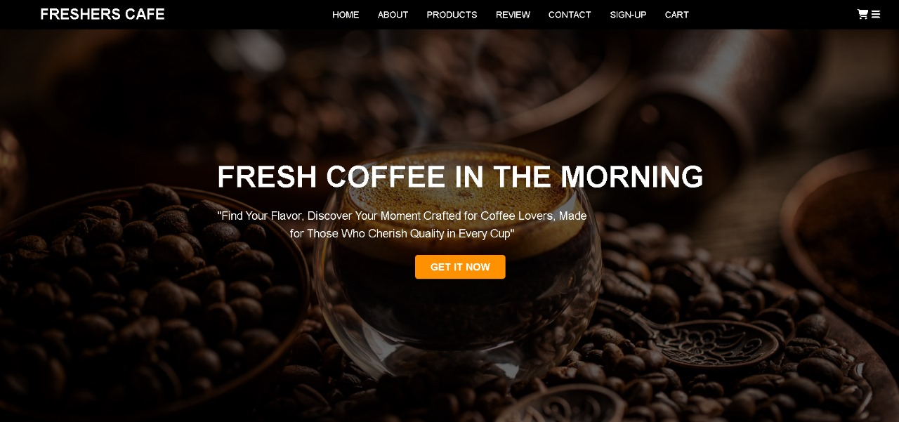
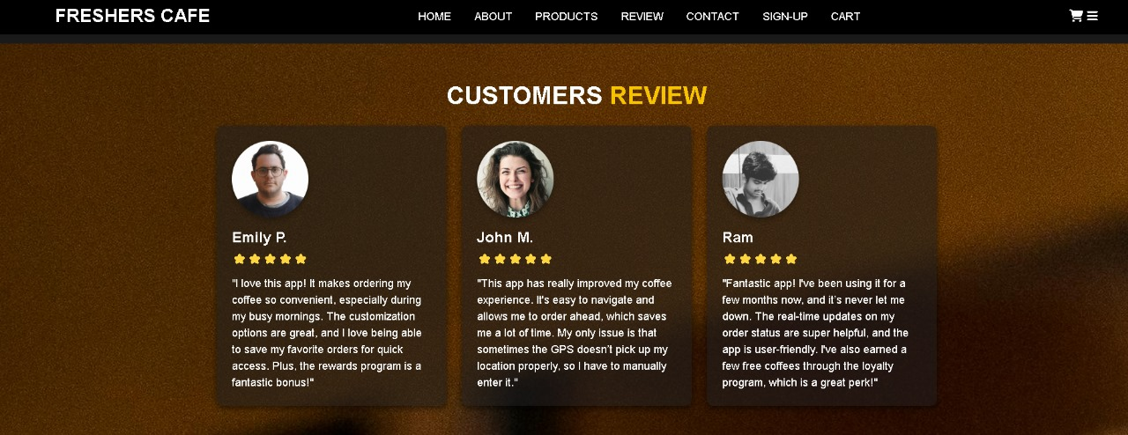

Slide 17
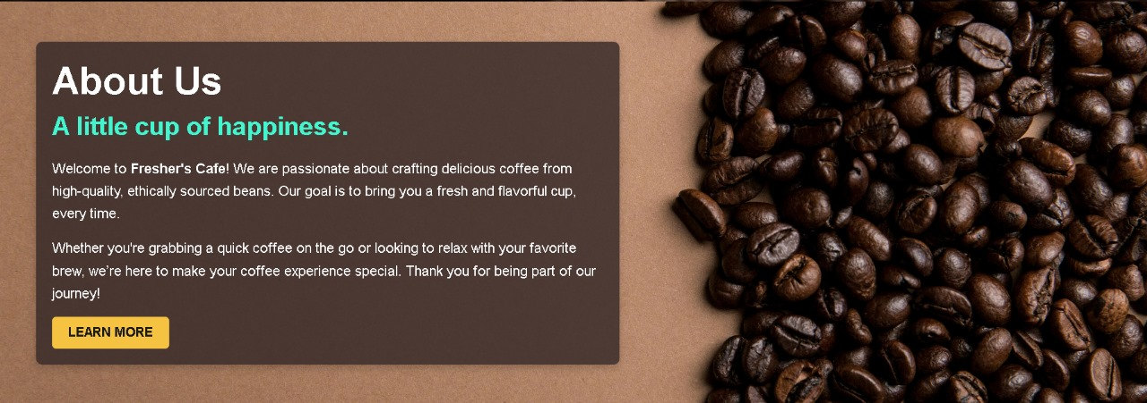
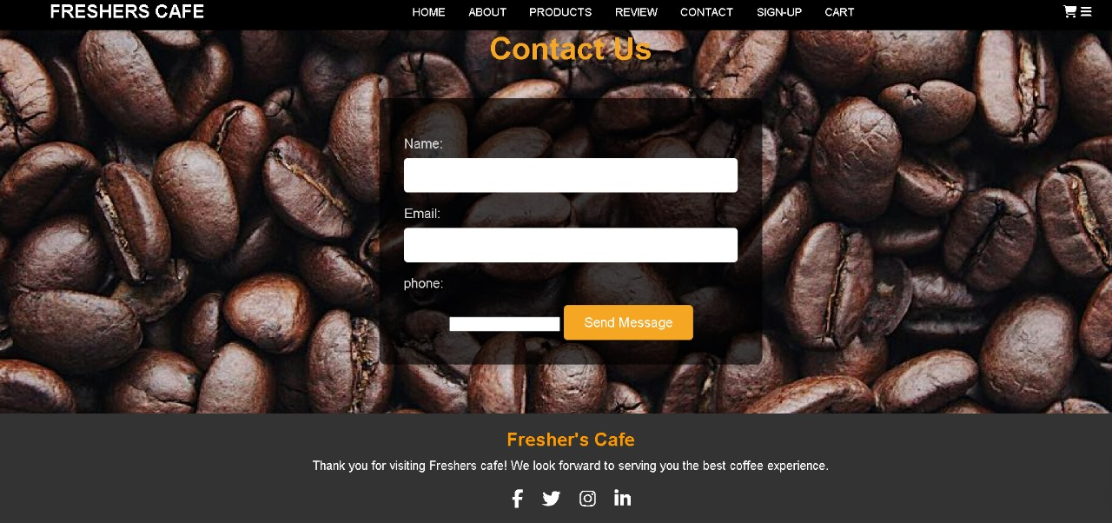
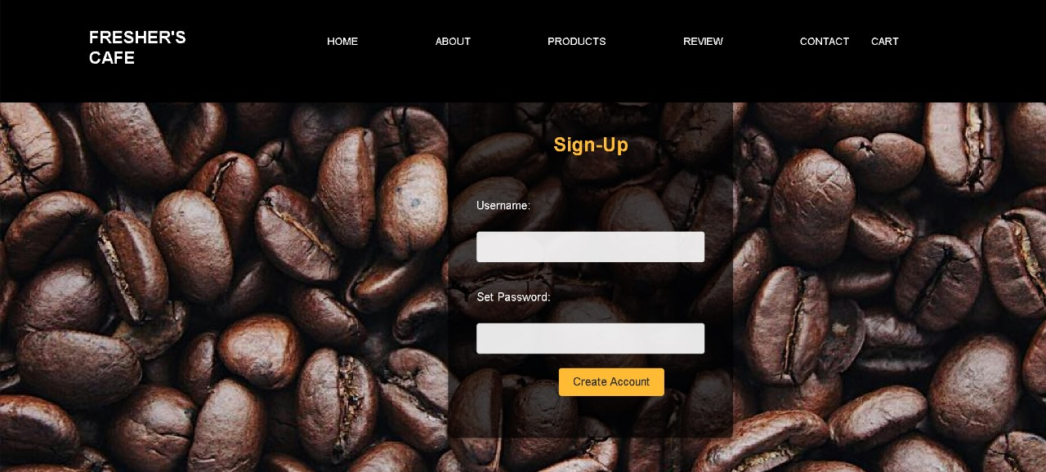
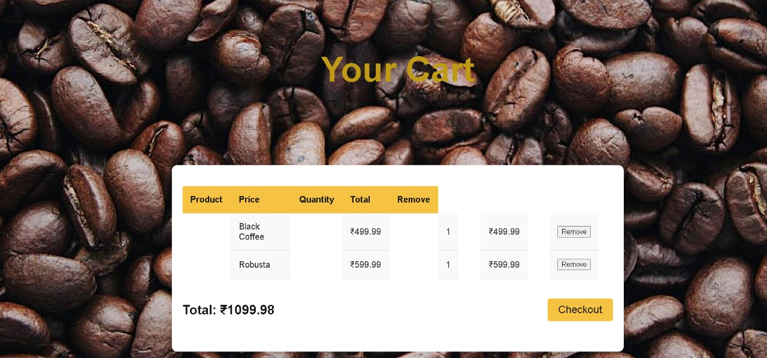

Slide 18
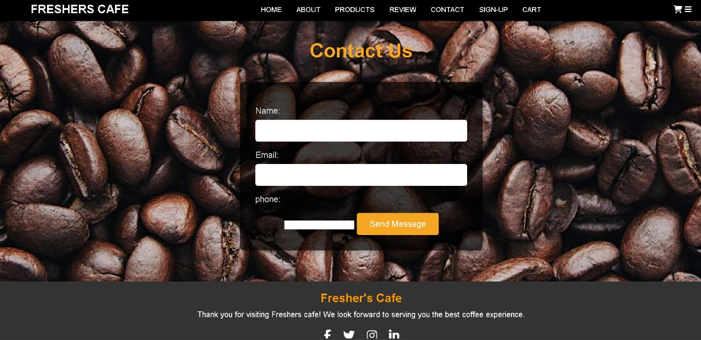

Slide 19


